Slide 1
Topic: Relative size of Decimal Numbers EQ: where did decimals come from and why do we use them?
Year 11 Essentials

Slide 2
Things Required For This Lesson
Interactive Notebook
Textbook: Interleaved Maths Essential Connections
Ruler, Red Pen, Pencil, Pens, Scientific Calculator
Growth mindset

Slide 3

24
7
30
Topic: Relative Size of Negative Numbers
Date: 12/02/2021
EQ: How do you use known and unknown information to find perimeter?
WICOR
This Photo by Unknown Author is licensed under CC BY-SA

Slide 4

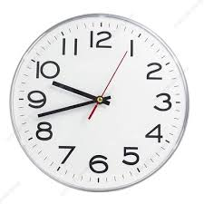
Interleave Questions set 2 Q4 -6
COPY AND SOLVE – UNDERLINE KEY WORDS
11 + 3² – 3 x 5 =
The Population for QLd in Dec 2018 was 5,052,800, NSW was 8,046,100 and VIC was 6,526,400. Use leading-digit approximation to estimate the total amount of people in these three states.
How many more people live in NSW than live in QLD?
What is the time on this analogue clock?
What will the time be in 2 and a quarter hours?

Slide 5
Interleave Questions set 2 Q4 -6
COPY AND SOLVE – UNDERLINE KEY WORDS
11 + 3² – 3 x 5 = 5
The Population for QLd in Dec 2018 was 5,052,800, NSW was 8,046,100 and VIC was 6,526,400. Use leading-digit approximation to estimate the total amount of people in these three states. 5 + 8 + 7 = 20 million
How many more people live in NSW than live in QLD? 2,993,300
What is the time on this analogue clock 9:43 (am or pm??) (how would you know?)
What will the time be in 2 and a quarter hours? 12:01am/00:01am/ 12:01pm

Slide 6
number system
In our number system we work on a base number.
The number is used when we have to more from one to tens, from tens to hundreds and from hundreds to thousands because we have too many to fit in that place. What number is this?
10
Notes:
Questions to ask. Are we adding 10 subtracting 10?

Slide 7
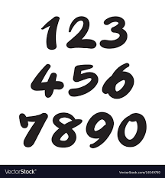
Base 10 number system
The numbers what we use every day are based on the base 10 number system
These 10 numbers are 0,1,2,3,4,5,6,7,8,9
Why do you think that 10 was a convenient number when it came to counting in early humanity when this system was developed?
Hint : It has to do with our bodies

Slide 8
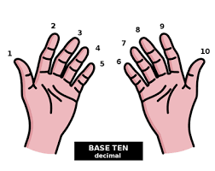

Base 10 number system
Each time we move one digit to the left in our base ten system, the number gets 10 times larger
10
100
1000
10,000
100,000
Notes:
Have students say what the next one should be getting larger

Slide 9

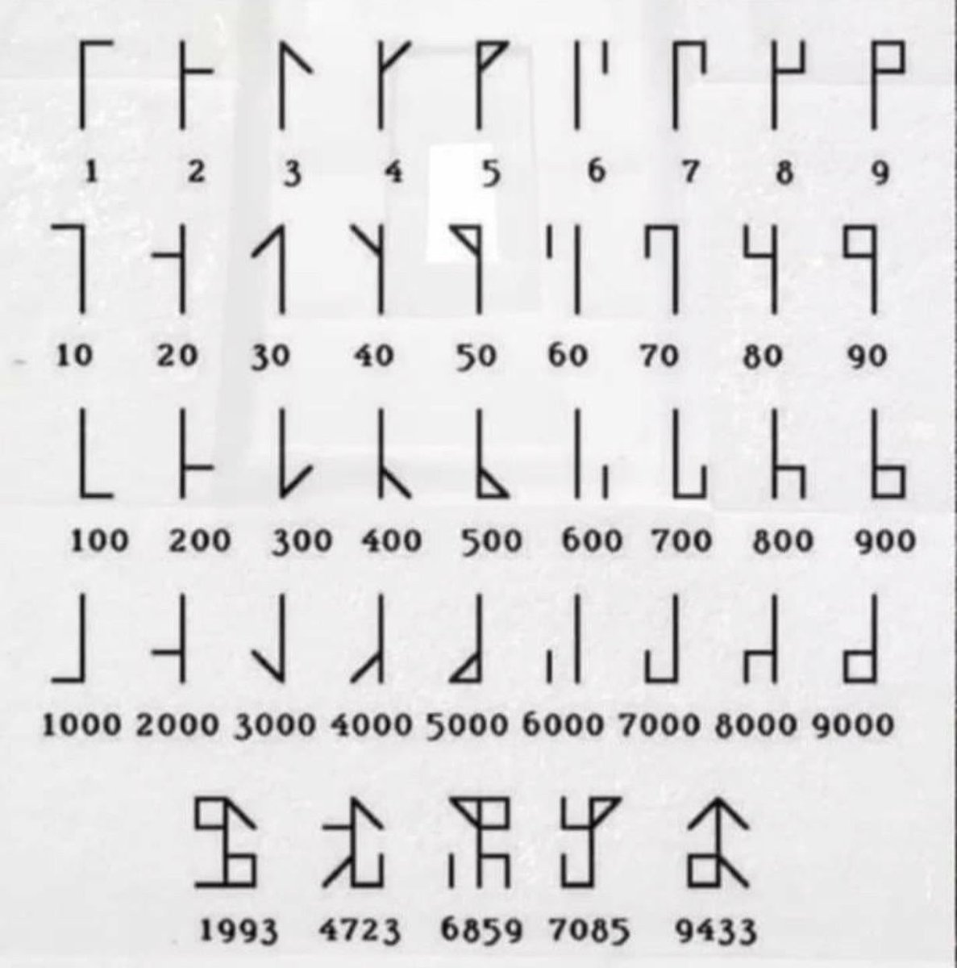
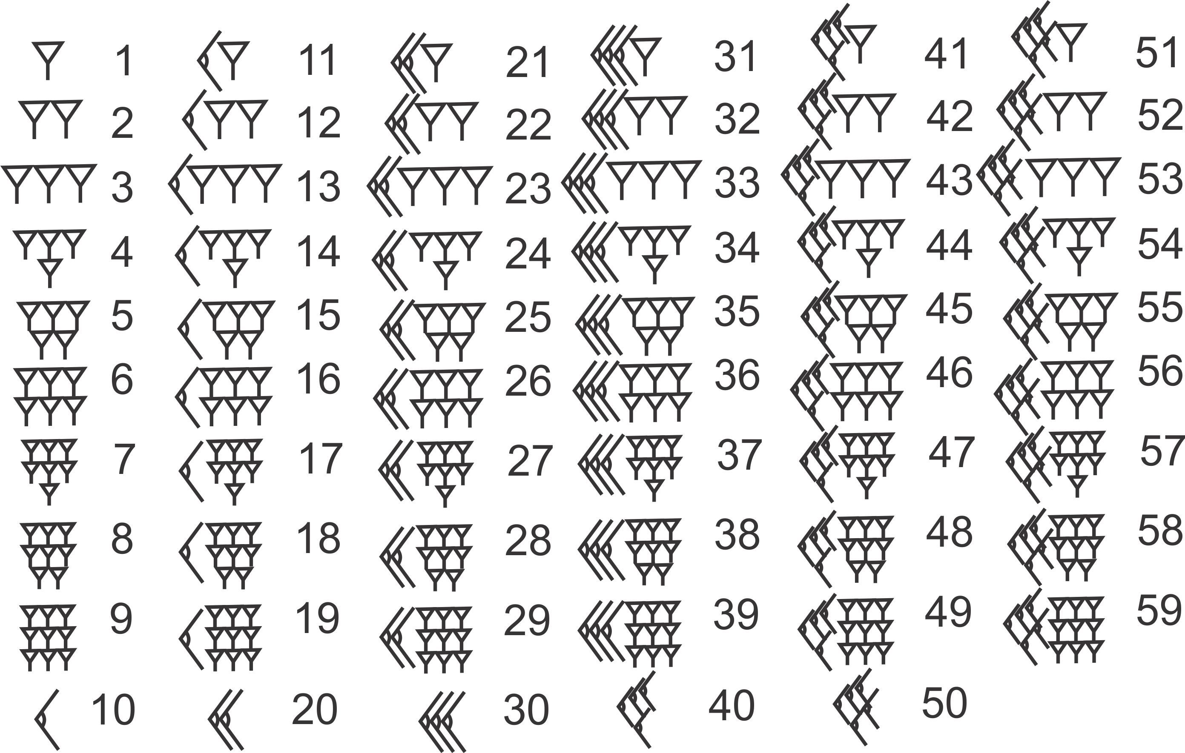
Base 10 number system – Other cultures
SUMERIAN
CISTERCIAN MONKS
Notes:
Cisterian monks lived in 12th century and in France, Germany, England, Wales, Scotland, Ireland, Spain, Portugal, Italy, Scandinavia and Eastern Europe.

Slide 10
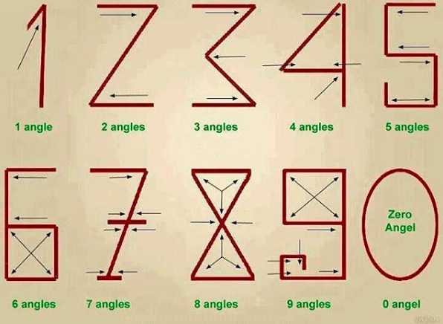
Base 10 number system – Interesting
Notes:
How the original numbers were written. Like with angles. Is this true or did someone make this up? How would we know?

Slide 11
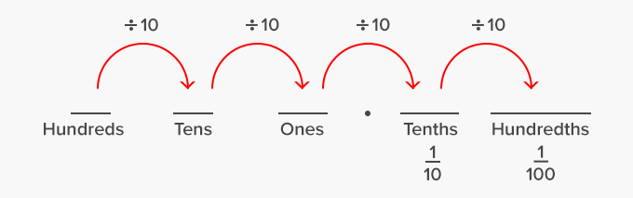
Base 10 number system - Decimal
Each time we move one digit to the left in our base ten system, the number is ten times larger for the example.
100 is ten times larger than 10.
Likewise, each time we move to the right, the number is ten times smaller. For example, 50 is ten times smaller than 500.
The same is true with Decimals. E.g. 0.1 is 10 times bigger than 0.01
Notes:
Talk about multiply and divide by 10 to move up each number ( x10 or divide by 10)

Slide 12
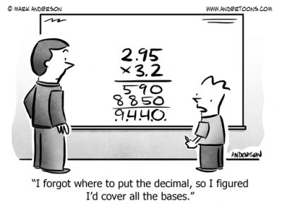
Origin of the word Decimal
Decimal (n.)
Deci is Latin for ‘tenth’
Decimal numbers are therefore “Base Ten”, So we can use it to understand converting fractions to decimals.
Copy into your books

Slide 13
Decimals - understanding
Now lets think about money as we know money uses decimals.
What is half of a dollar?
Now write this is dollars and cents.
That is how we write half as a decimal.
Now what is one quarter of a dollar?
Now write this as dollars and cents
That is how we write half as a decimal.
Notes:
Draw on board and discuss with class

Slide 14
Decimals - understanding
Now draw a number line with the 0 at the left end and 1 at the right end.
Use the strategy Of a dollar to convert the following fractions into decimals and write them on the number line.
One tenth, two tenths, three tenths, one half, one quarter, one fifth, two fifths.
Notes:
Have students say what the next one should be getting larger

Slide 15
Decimals - understanding
What key positions do you use to help figure out positions on your number line?
Why don’t we add numbers to the right hand side of decimal numbers?
When might we write 0’s to the right of a decimal in the real world?
Notes:
Have students say what the next one should be getting larger

Slide 16
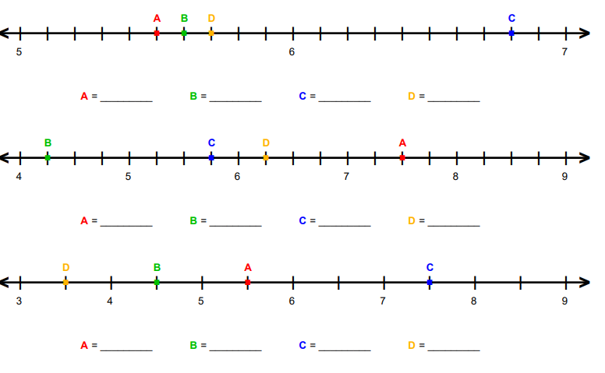
Notes:
If youd prefer to print this page go here.
https://www.math-aids.com/cgi/pdf_viewer_7.cgi?script_name=number_lines_decimals.pl&denom_2=1&denom_4=1&denom_5=1&denom_10=1&pos_neg=0&format=1&language=0&memo=&answer=1&x=67&y=41

Slide 17
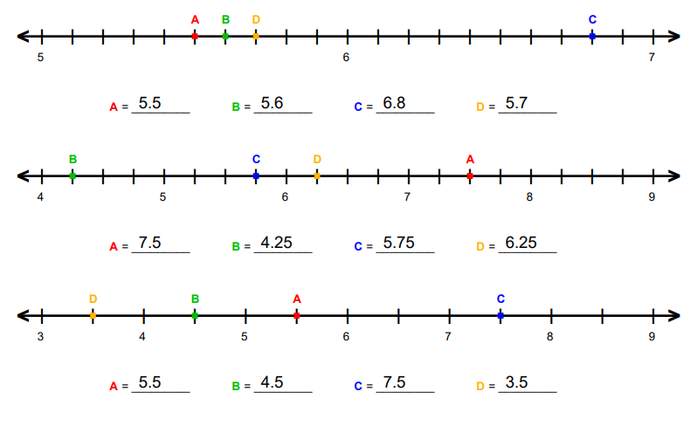
Notes:
If youd prefer to print this page go here.
https://www.math-aids.com/cgi/pdf_viewer_7.cgi?script_name=number_lines_decimals.pl&denom_2=1&denom_4=1&denom_5=1&denom_10=1&pos_neg=0&format=1&language=0&memo=&answer=1&x=67&y=41

Slide 18
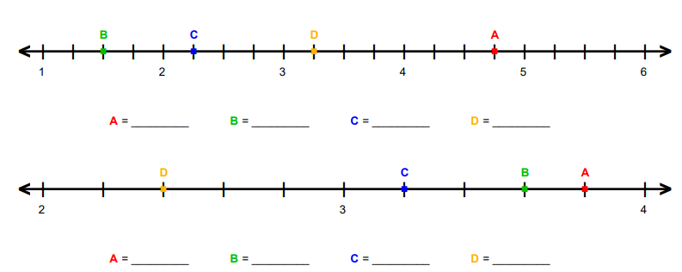
Notes:
If youd prefer to print this page go here.
https://www.math-aids.com/cgi/pdf_viewer_7.cgi?script_name=number_lines_decimals.pl&denom_2=1&denom_4=1&denom_5=1&denom_10=1&pos_neg=0&format=1&language=0&memo=&answer=1&x=67&y=41

Slide 19
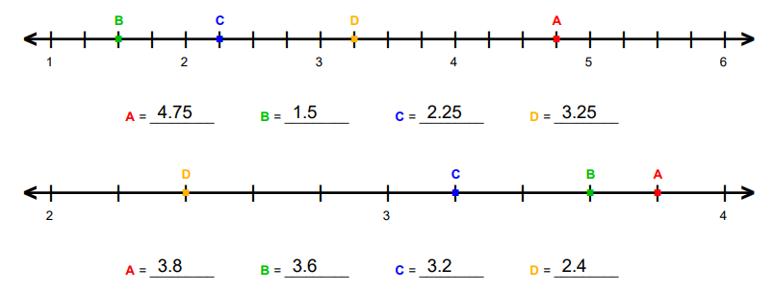
Notes:
If youd prefer to print this page go here.
https://www.math-aids.com/cgi/pdf_viewer_7.cgi?script_name=number_lines_decimals.pl&denom_2=1&denom_4=1&denom_5=1&denom_10=1&pos_neg=0&format=1&language=0&memo=&answer=1&x=67&y=41

Slide 20
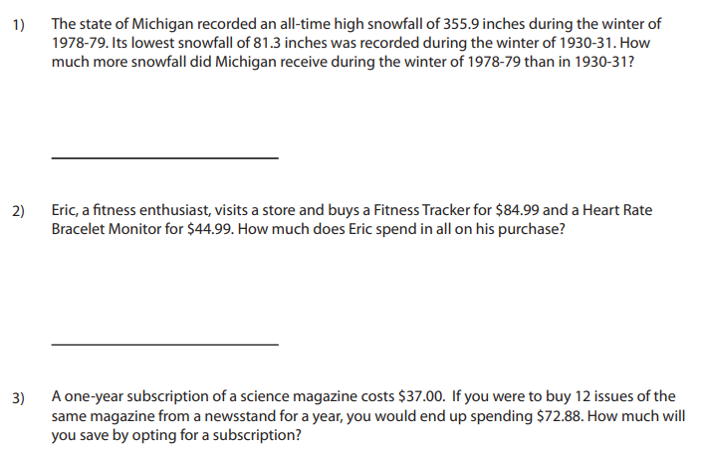
Worded
Question
Notes:
If youd prefer to print this page go here.
https://www.mathworksheets4kids.com/decimals/word-problems/customary/add-sub1.pdf

Slide 21
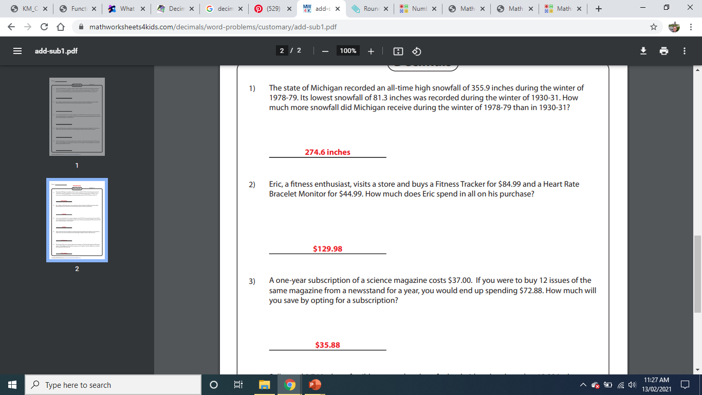
Worded
Question
Notes:
If youd prefer to print this page go here.
https://www.mathworksheets4kids.com/decimals/word-problems/customary/add-sub1.pdf

Slide 22

Thank you
Keep up the good work!
Quote of the day –
“YOU’RE BRAVER THAN YOU BELIEVE, STRONGER THAN YOU SEEM, SMARTER THAN YOU THINK”

